Slide 1


Getting Started with Skype for Business

Slide 2
Overview
Install Skype for Business Desktop App.
Navigate Skype for Business windows.
Start IM, voice call or video call.
Work with contacts.
Using Skype for Business in an online meeting.
Share a MS document.
Skype for Business with smart phones and docks.
Which Skype should I use?
Skype for Business is for connecting with a co-worker or business associate.
Skype is for connecting with your grandma, or chatting with friends while gaming.

Slide 3
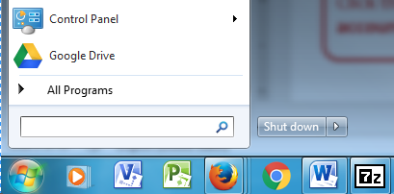
Before Installing Skype for Business Desktop App
1
Click Windows Start Button.
2
Search for Skype for Business. If you have the program, skip the installation process, otherwise, continue.
3
3
3
3
3
3
3
3
3
3

Slide 4
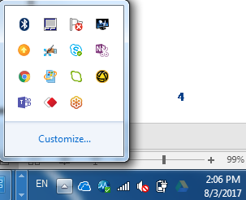
Install Skype for Business Desktop App on your AU Device
1
If you can not see the Altiris icon in the Windows Notification Area. Press this pop-up button to display a complete list of the available services.
2
2
Click Altiris button. If you could not find it please contact help desk.
4
4
4
4
4
4
4
4
4
4

Slide 5
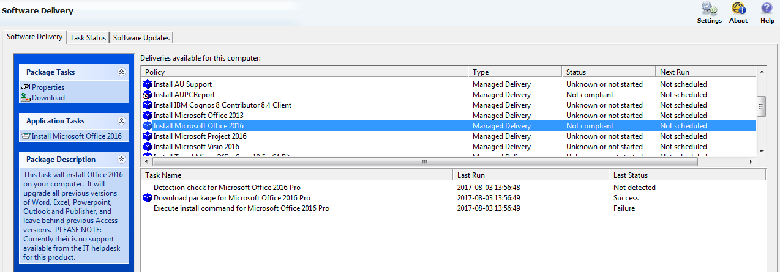
Install Skype for Business Desktop App on your AU Device
2
Left click on the line under Application Tasks.
1
2
Scroll down until you locate Install Microsoft Office 2016, and then left click it one time.
5
5
5
5
5
5
5
5
5
5

Slide 6
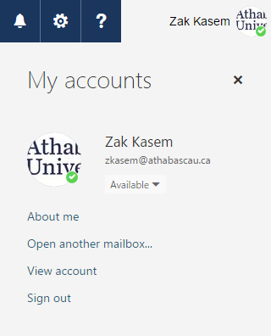
Install Skype for Business Desktop App on your Home Device
1
Click your account profile picture on the upper-right corner of Office365.
2
Click the View account link.
6
6
6
6
6
6
6
6
6
6

Slide 7
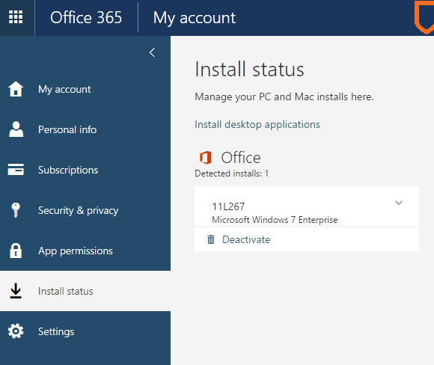
Install Skype for Business Desktop App on your Home Device(1)
2
Click the Install desktop applications link.
1
Click the Install status section

Slide 8
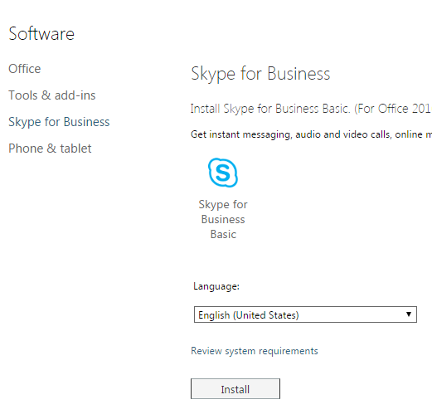
Install Skype for Business Desktop App on your Home Device(2)
1
Click the Skype for Business link under the Software menu.
2
Click the Install button.

Slide 9
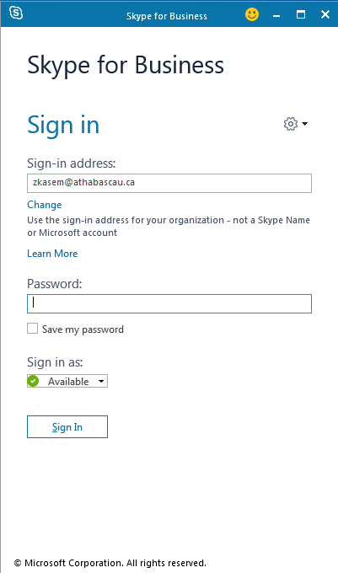
Access Skype for Business
Enter your AU address including @athabascau.ca, and your AU Local password, and then tap the Sign In Button.
1
2
3

Slide 10
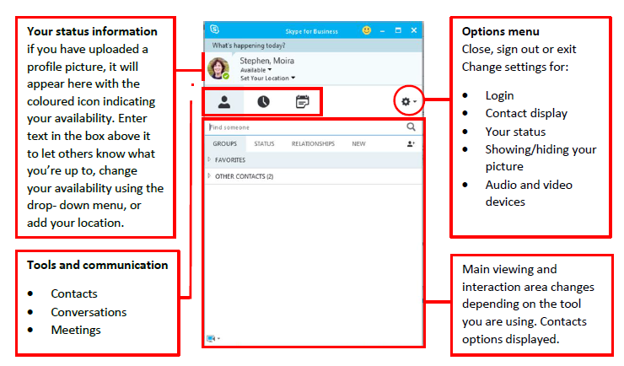
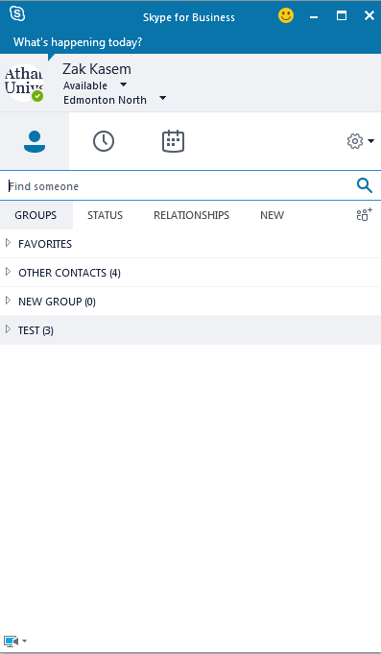
Navigate the Main Skype Window

Slide 11
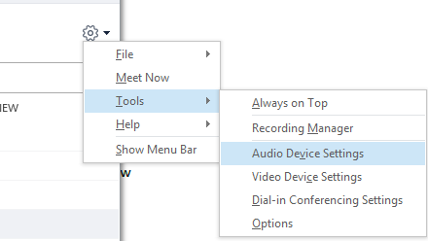
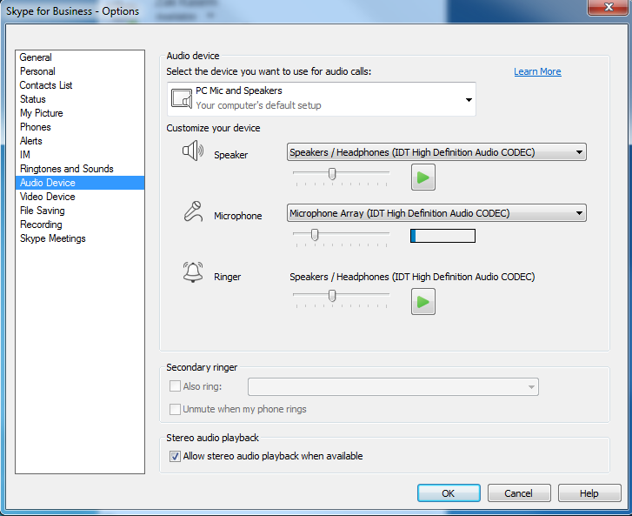
Audio setup and making calls
Set up your audio device
First things first: set up your audio device and check the quality. You can use your computer’s mic and speakers, plug in a headset.
Click Select Your Primary Device in the lower-left corner of the main Skype for Business window.
Click Audio Device Settings.
Pick your device from the Audio
Device menu, and adjust the
speaker and mic volume.

Slide 12
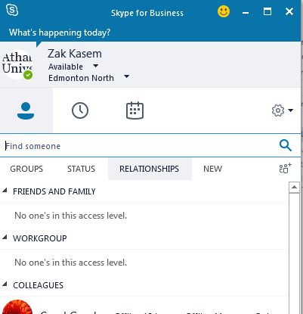
Find Someone
2
Click the Search button.
1
Type a name in the Search box. As soon as you do, the tabs below displays all names that matches your search criteria.

Slide 13
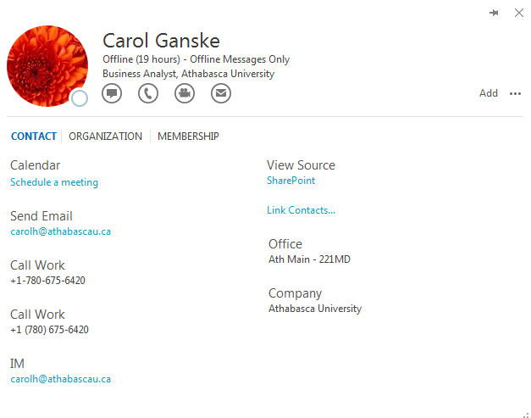
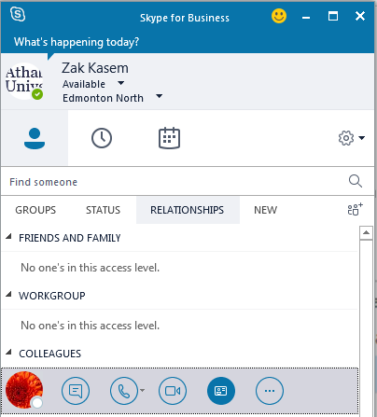
View a Contact Card
2
Click the Contact Card button.
1
Tap a contact picture.

Slide 14
Start IM, Voice Call, or Video Call
Tap here to start voice call.
Tap here to start IM.
Tap here to start video call.
Notes:
https://support.office.com/en-us/article/Control-access-to-your-presence-information-in-Lync-2fbfdcc5-d04b-49fe-ad90-264a42f7cce1

Slide 15
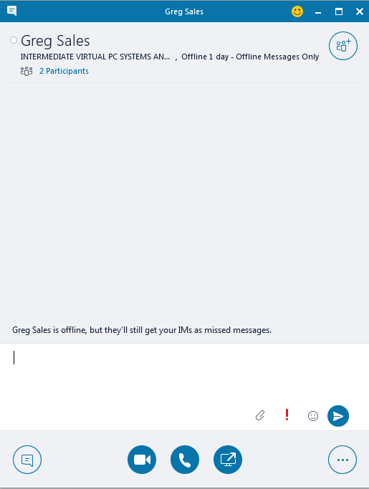
Navigate the Instant Message Window
Conversation Area
Invite more people.
New message area
Notification tools:
Attachment
Importance
Emoticon
Send

Slide 16

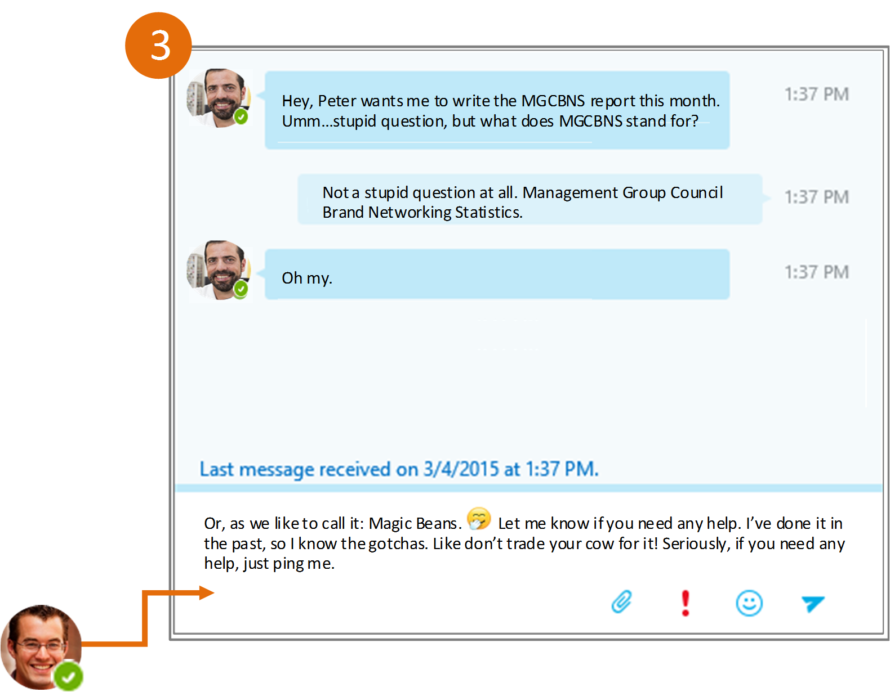
Send an Instant Message
Use instant messaging (IM) to touch base with your contacts right away.
In your Contacts list, point to
the contact you want to IM. If
you want to IM with more
than one contact, hold down
the Ctrl key and click each
contact name.
Click the IM button.
Type your message and
press the Enter key on
your keyboard.
Need to add someone to
the IM?
From the main Skype for Business window, drag a contact pic onto the IM window.

Slide 17
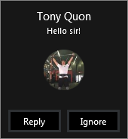
Responding to an IM Alert
When someone starts a new IM conversation with you, an alert pops up on your screen.
  To see the message, click anywhere on the photo area to accept it. The IM conversation window will open to display the message.
  To reject the message, click Ignore. The message goes to your Outlook Inbox.
If you do not want to receive new IM alerts, set your presence status to Do Not Disturb You can do this using the Options menu on the alert box or see Displaying your availability: Presence.

Slide 18
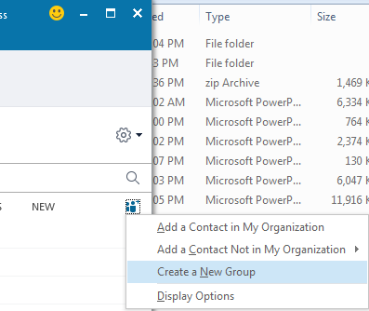
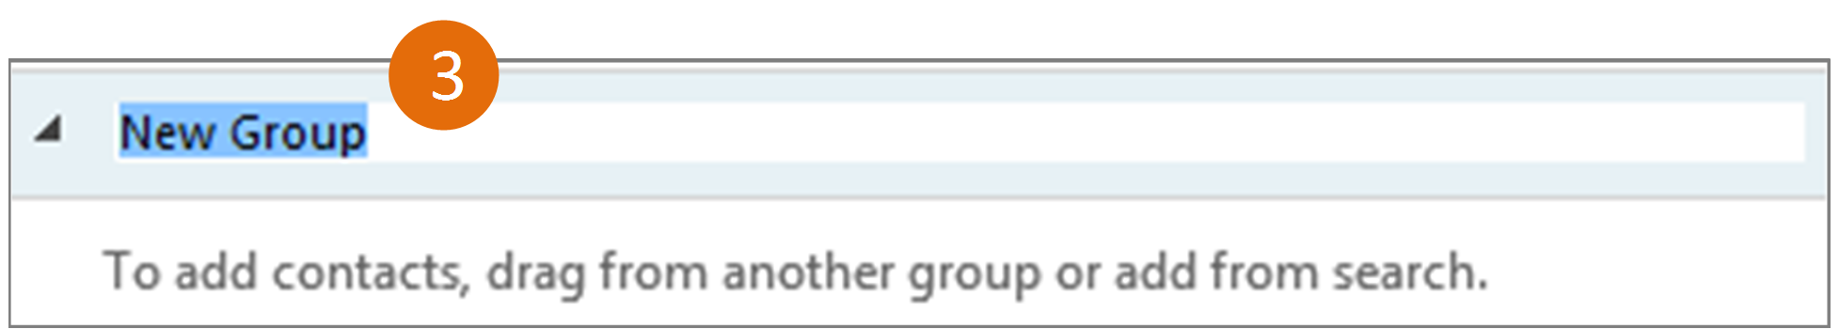
Create a New Group
Set up a group for each team you work with so you quickly see who’s available, or communicate with the entire team at once.
1
Click the Add a Contact button.
2
Select Create a New Group.
3
Begin typing your new group name.

Slide 19
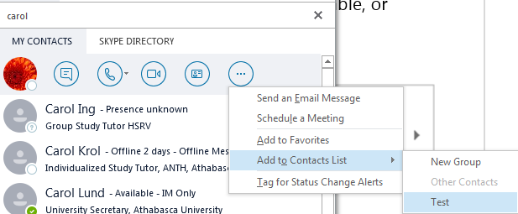
Add a contact to a Group
1
Search for the contact and Tap a contact picture.
2
Click the More button.
3
Tap Add to Contacts List.
4
Choose the group.

Slide 20
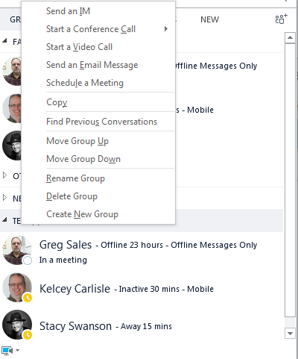
Working with Groups
1
Tap Group.
3
You can perform all of these functions with all contacts in this group.
2
Right click the group you want to work with.

Slide 21

Demo

Slide 22
Using Skype for Business in an Online Meeting
Set up a Skype for Business meeting.
Attend a meeting using Skype for Business Desktop App (Recommended to AU staff).
Attend a meeting using Skype for Business Web App (Recommended to external guests).
Share a content.
Record a meeting.

Slide 23
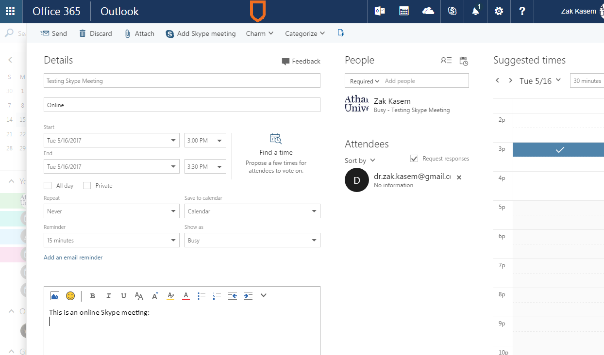
Set up a Skype Meeting
Double click your Office 365 Calendar to set up a meeting. Enter all meeting details and then click Add Skype Meeting.

Slide 24
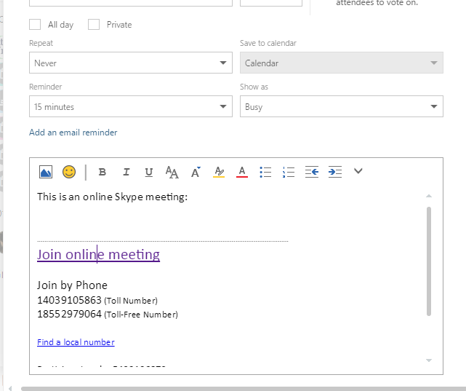
Set up a Skype Meeting (1)
Meeting details will be added automatically to the body of the meeting invitation.

Slide 25
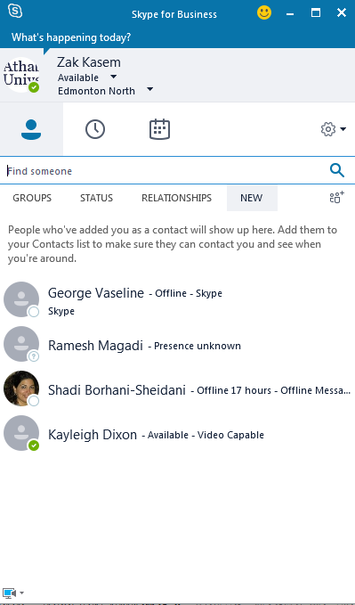
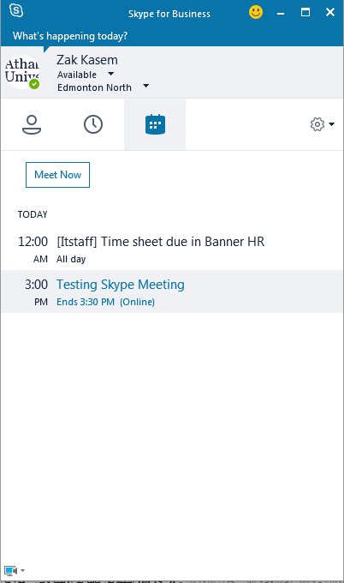
Attend a Meeting using Skype for Business Desktop App
Install and run the Skype for Business desktop application.
1
Click the Meetings button.
2
Click the meeting that you would like to attend.

Slide 26
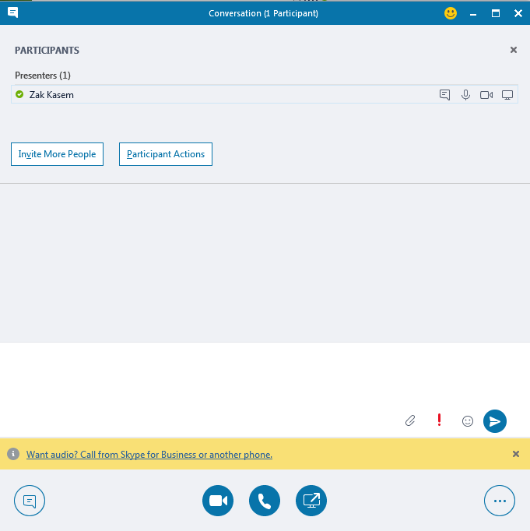
Attend a Meeting using Skype for Business Desktop App (1)
The meeting will start and a list of the participants will be displayed at the top of the conversation.
Wait for the participants to join the meeting.

Slide 27
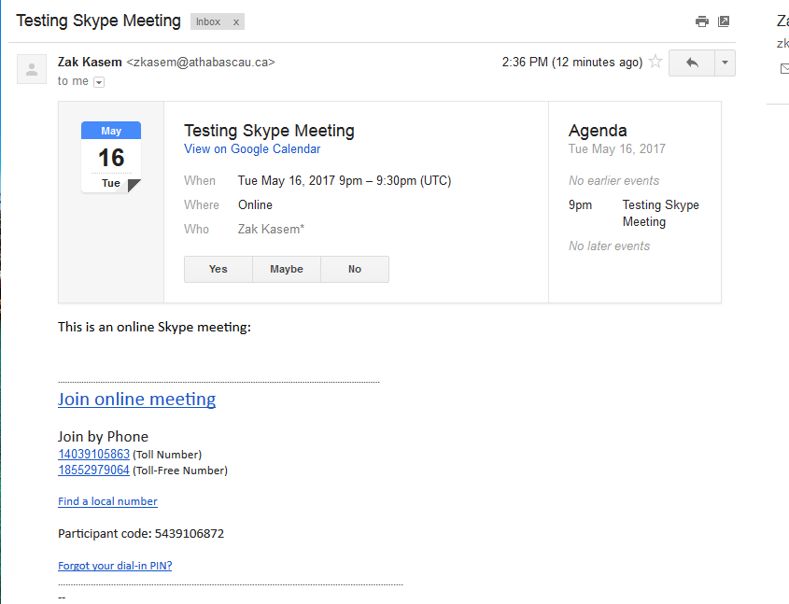
Attend a Meeting using Skype For Business Web App
If you are a guest and you are invited to a Skype meeting, an automatic email message will be sent to your email address. You should call the phone number and enter the participants code and then click the Join online meeting link.

Slide 28
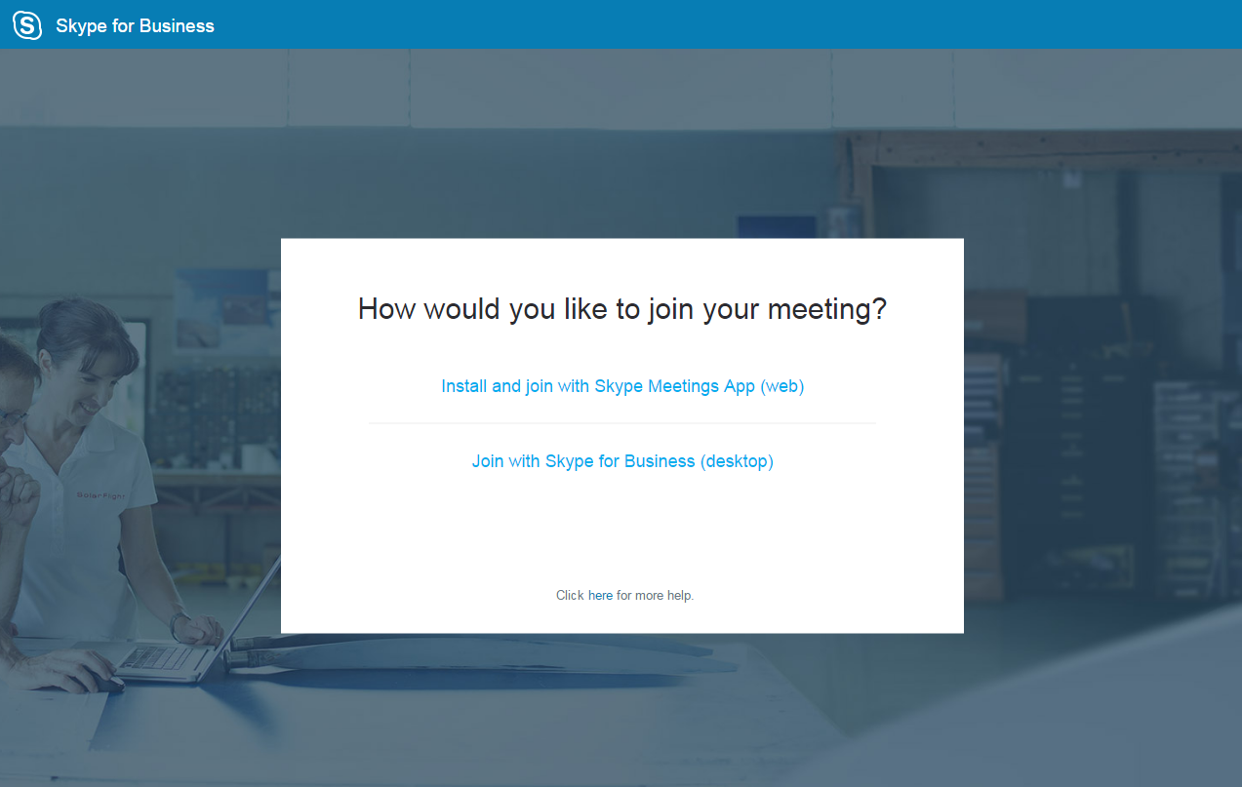
Attend a Meeting using Skype For Business Web App (1)
If you do not have a Skype for Business account click Install and join with Skype meetings App (web).

Slide 29
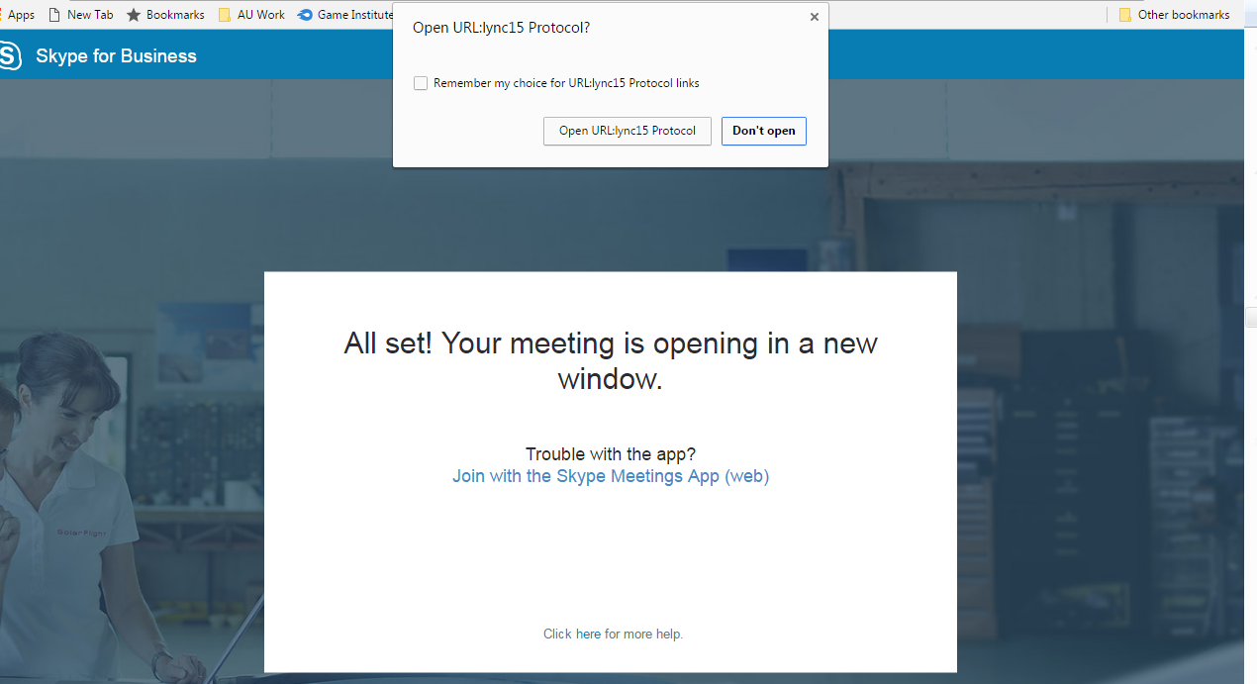
Attend a Meeting using Skype For Business Web App (2)
First time you use Skype for Business Web App, you need to allow the Lync protocol by clicking the Open URL:lync15 Protocol.

Slide 30
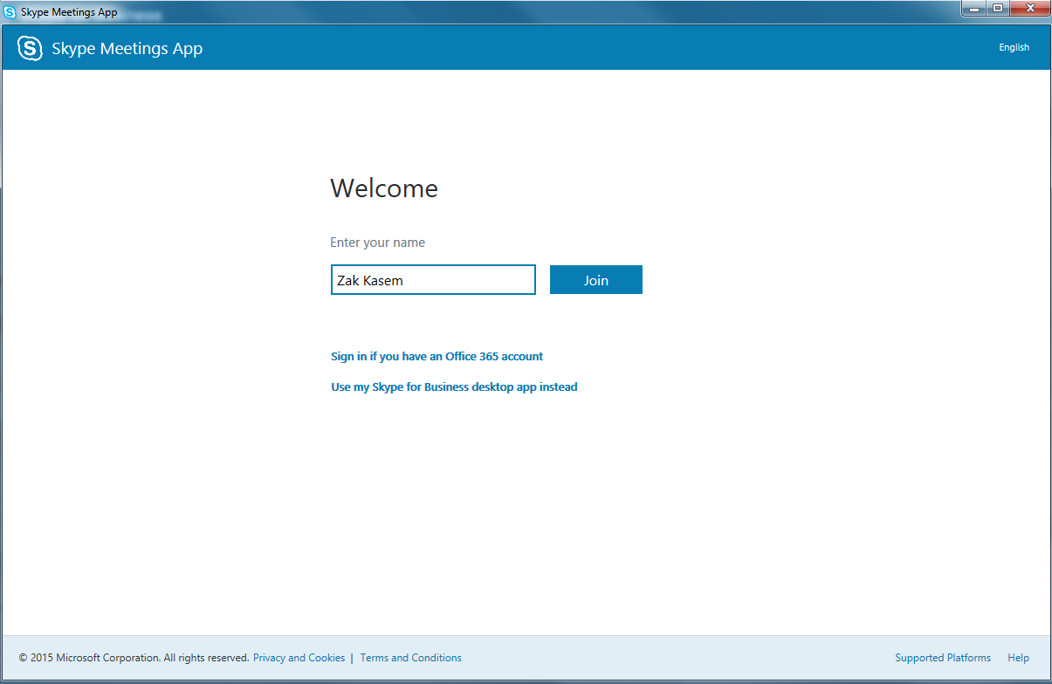
Attend a Meeting using Skype For Business Web App (3)
Type your first and last name and then click the Join button.

Slide 31
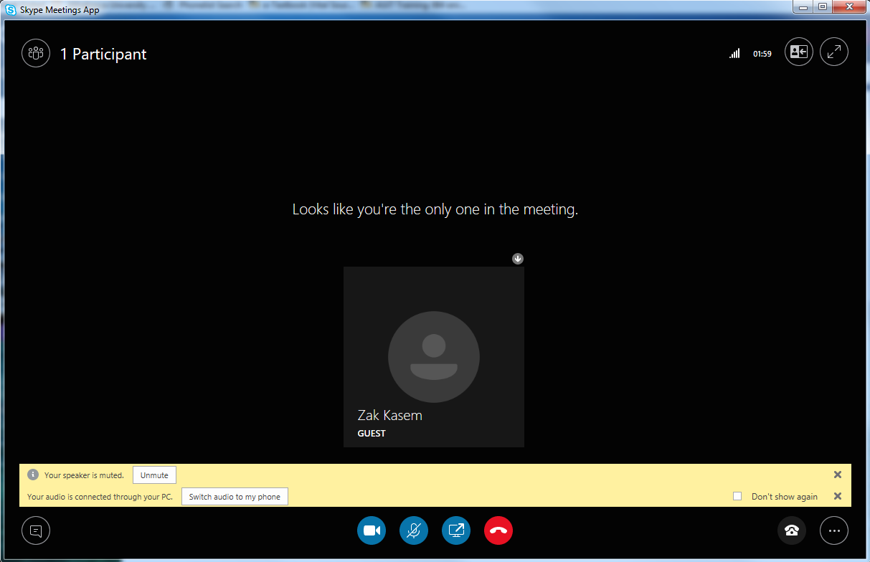
Attend a meeting using Skype For Business Web App (4)
Now you joined the meeting and you can see the other participants and the host.

Slide 32
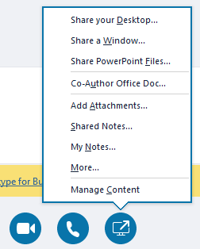
Share your Desktop or Program
In the meeting window, click the Present button.
Click Share your Desktop… to show the entire contents of your desktop, or click Share a Window… and double-click the program you want to share.
Click Share PowerPoint Files… Browse to the file you want to present and click OK.
2
1

Slide 33
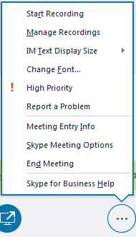
Record and Play Back a Meeting
It’s easy to capture audio, video, IM, and what’s being presented.
In the meeting window, click the More Options button.
Click Start Recording.
After the meeting, go to Manage Recordings to publish, play, rename, or delete the recording.
2
1

Slide 34
Demo

Slide 35
Share a MS Document
Present a MS document online.
Send a MS document by Instant Message.

Slide 36
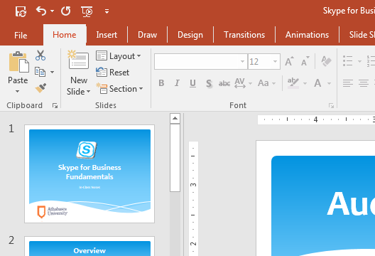
Present a MS Document Online
Open your MS Office document that you want to present online and then click File.

Slide 37
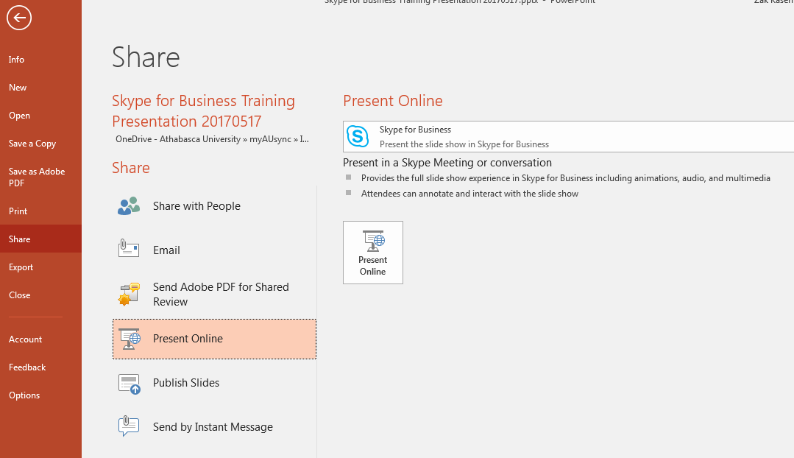
Present a MS Document Online (1)
1
Click Share.
3
Click Present Online.
2
Click Present Online.

Slide 38
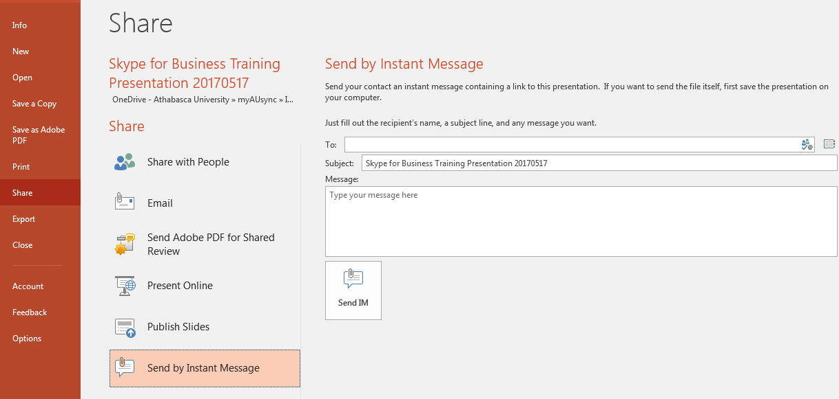
Send a MS Document by Instant Message
3
Fill all the fields and click Send IM.
1
Click Share.
2
Click Send by Instant Message.

Slide 39
Demo

Slide 40
Skype for Business IOS App

Slide 41
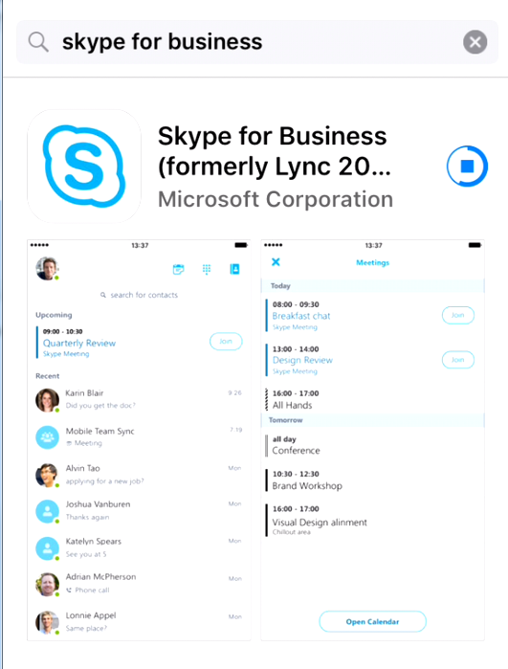

Install Skype for Business IOS App
Use this field to search for Skype for Business
2
1
From your phone, click the App Store icon.

Slide 42
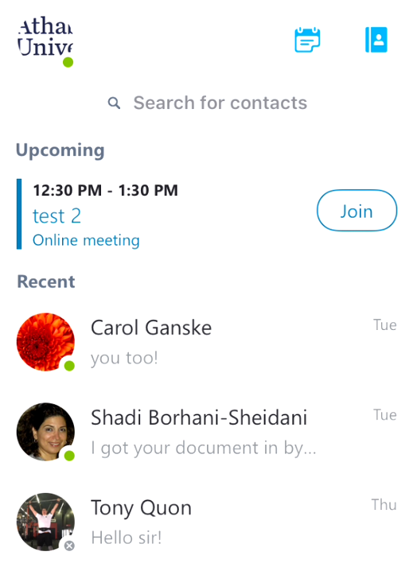
Using Skype for Business IOS App
Click the Meeting icon to see more meetings
Click your profile picture to change your Status, Settings, Profile, sign out or getting help.
Use this field to search for a contact
Tap the Join button to access the meeting

Slide 43
Demo

Slide 44
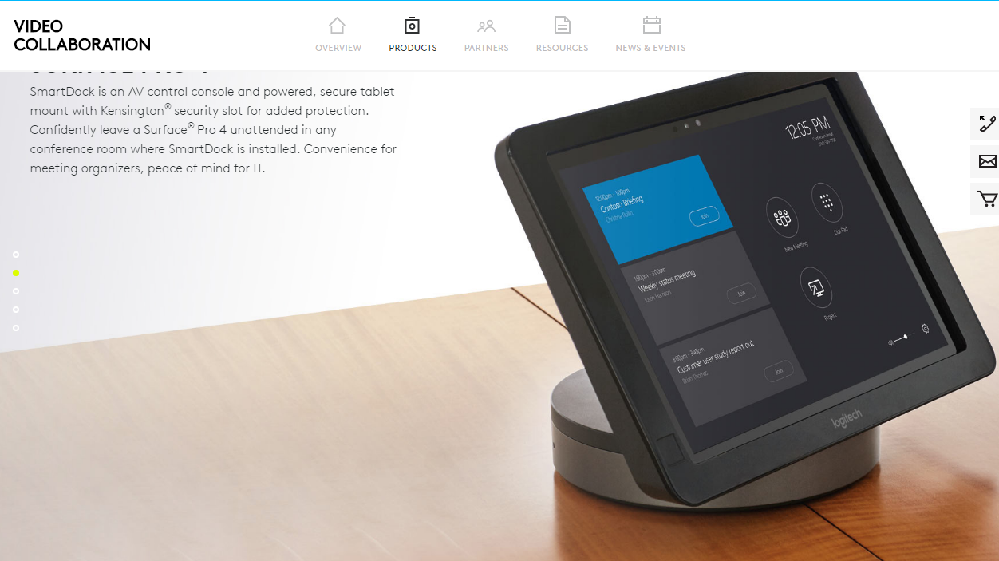
Logitech Smart Dock
Logitech Smart Dock
Notes:
https://www.youtube.com/watch?v=Y0VZGgdI420

Slide 45
Practice

